Slide 1

GATEKEEPER
Rebecca McFadden
Nikhitha Vempati
Cora English
Grace Li

Slide 2
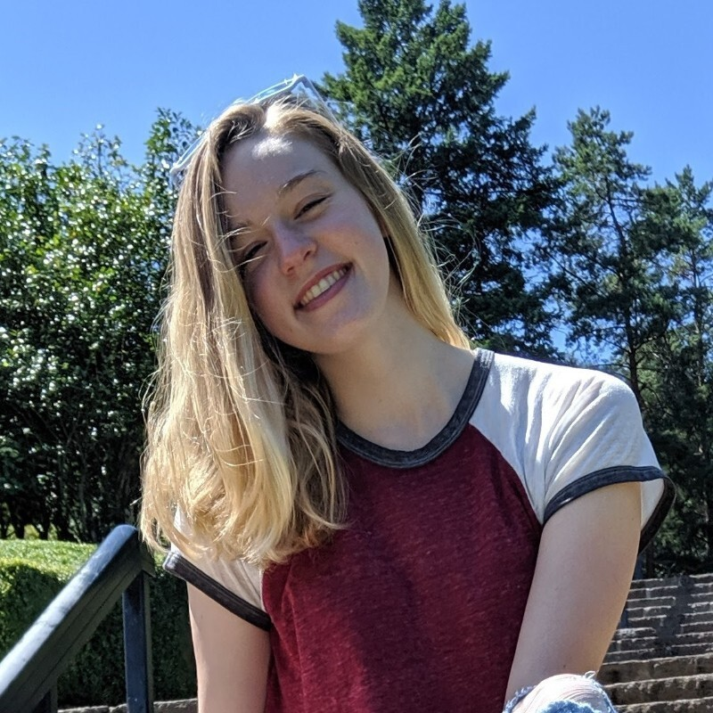



Team 1
Rebecca McFadden
Scrum Master
Product Owner
Cora English
Grace Li
Nikhitha Vempati
~ gaslight ~ gatekeep ~ girlboss ~

Slide 3
Problem Statement
People often pay for services/subscriptions that they don’t use
It can be difficult to keep track of every subscription in a structured way
If not properly tracked, you can miss cancellation periods and pay extra for a service you don’t use anymore / a subscription you intended to cancel
Family members / roommates often pay separately for the same service

Slide 4
Introduction
Gatekeeper is a service manager with the following features:
Allow users to create/edit profiles
Store passwords for various subscription services
Share passwords securely between different groups and temporary sharing links
Receive billing and cancellation reminders for different services
Search for platforms to stream shows and movies on
View user sitewide, group and personal cost statistics

Slide 5






Design
sign in with Google
or create an account
on Gatekeeper
USER
SERVICES
GROUPS
REMINDERS
STATISTICS
SEARCH
securely store passwords
create groups to share with
schedule billing & cancellation
view various cost statistics
.*non-user feature
find where to watch shows
.*non-user feature

Slide 6
Challenges & Lessons Learned
The client knows what they want, meet with them often
Agile is great for changing requirements
Underpromise, overdeliver
Working on a team has its ups and downs
Senioritis hits HARD - take this class as a junior :)

Slide 7

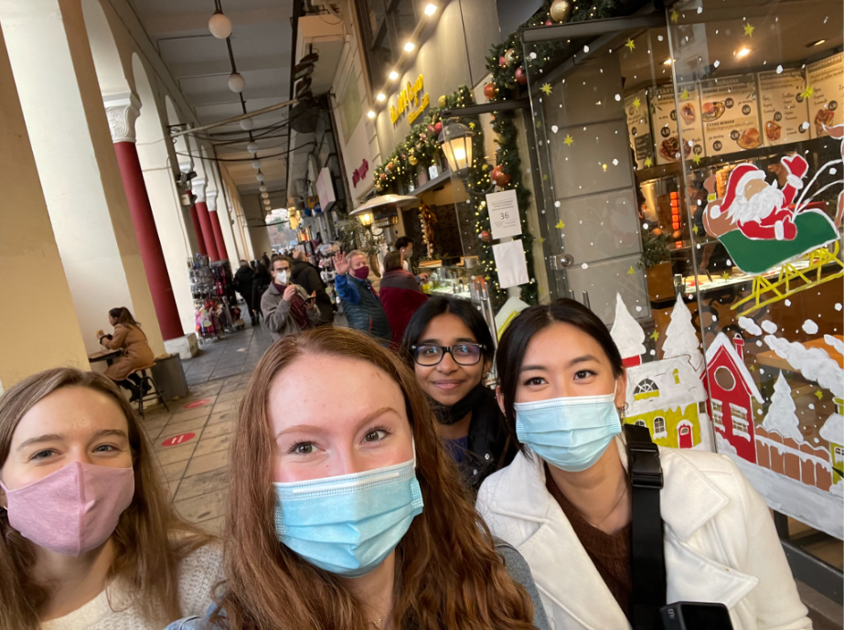
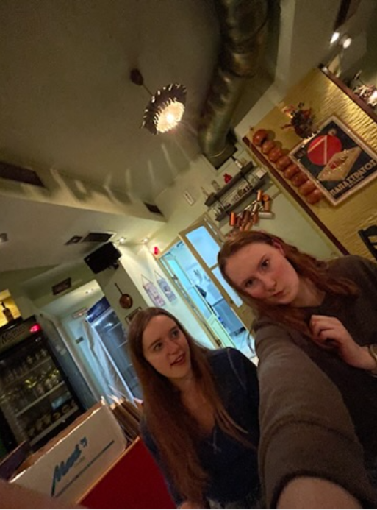
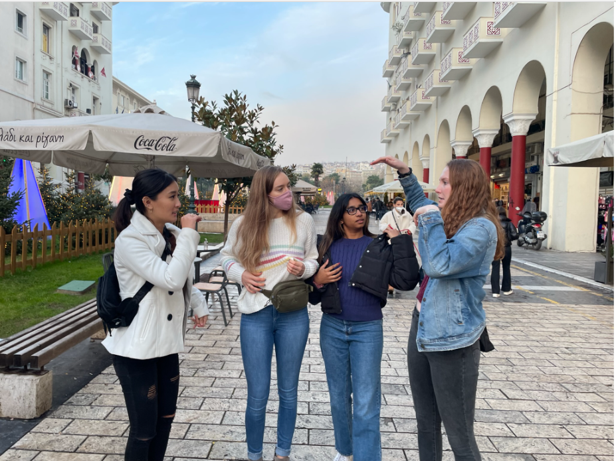


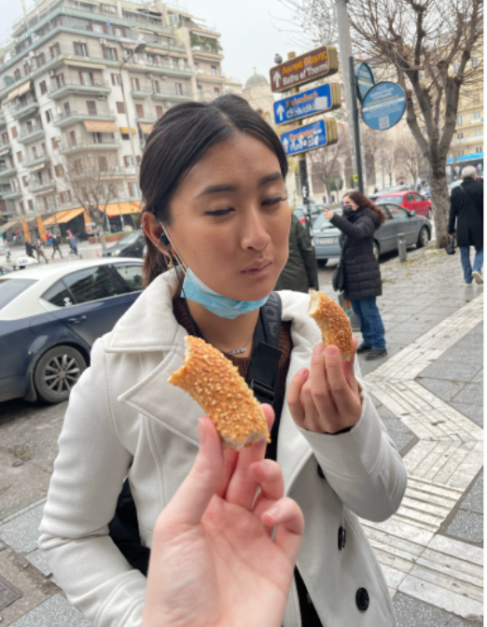
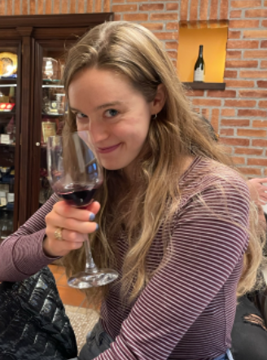
Ευχαριστώ

